Slide 1
Sales Data Analysis Using Python
Prepared by Mr.Hareesh

Slide 2
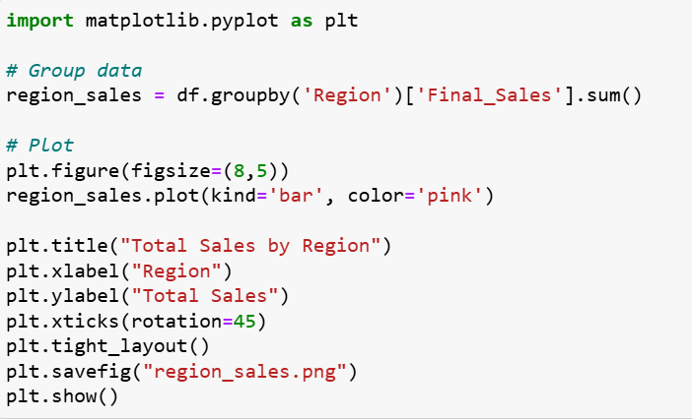
Sales by Region

Slide 3
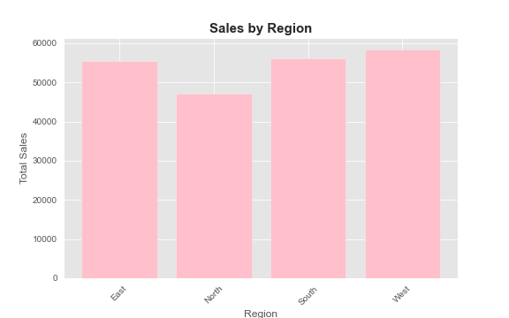
Bar chart → Sales by Region

Slide 4
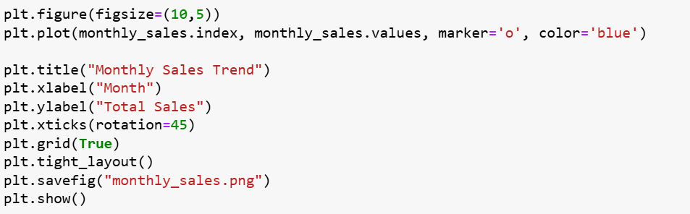
What is the monthly sales trend?

Slide 5
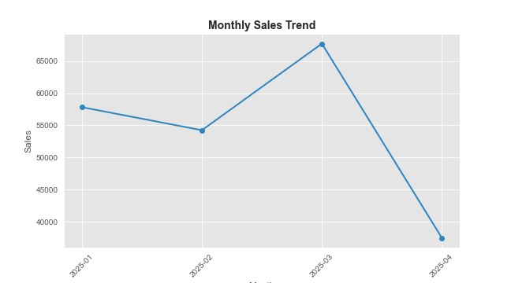

Slide 6
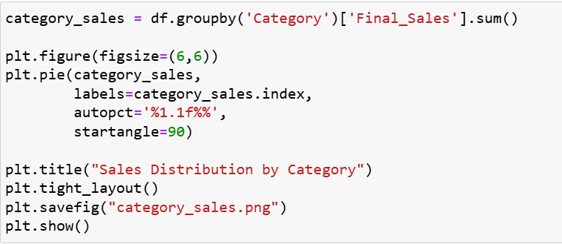
Category distribution

Slide 7
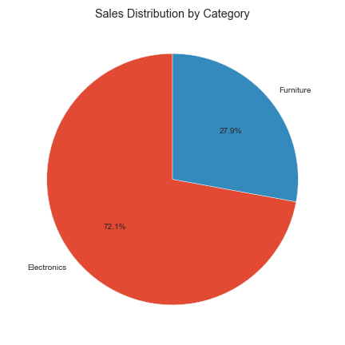
Pie chart → Category distribution

Slide 8
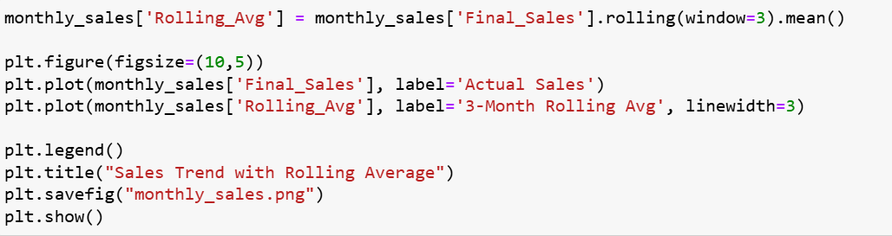
Add rolling average to trend chart

Slide 9
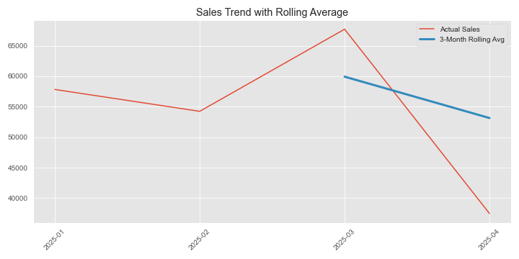

Slide 10
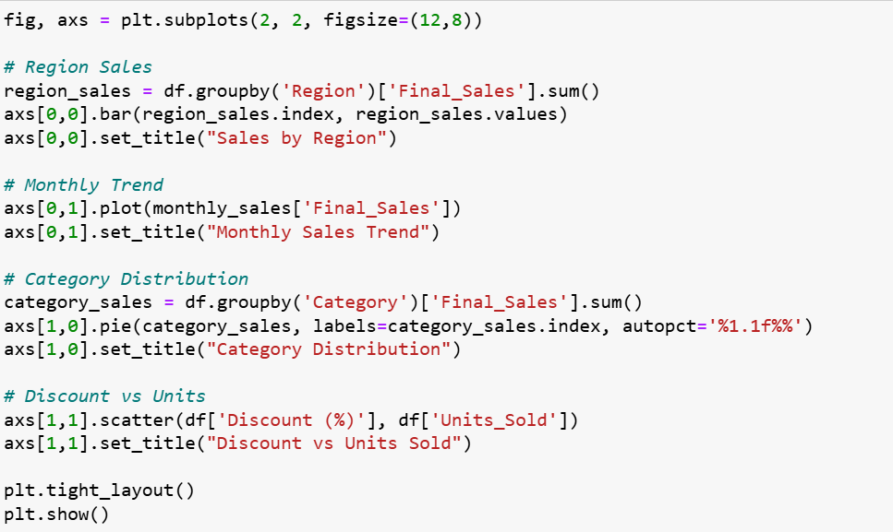
Create sales dashboard style visualization

Slide 11
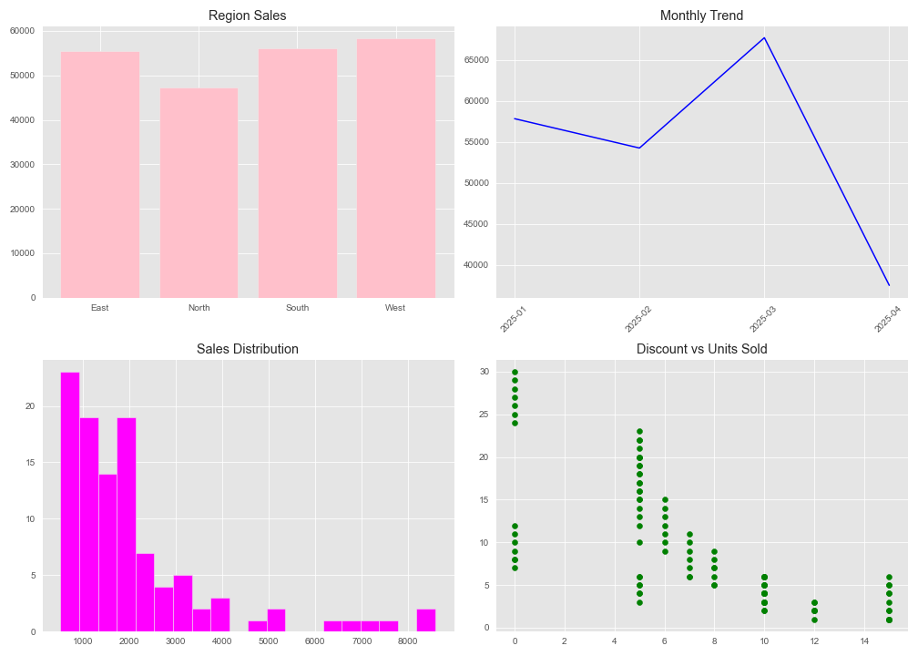

Slide 12
THANK YOU

